Slide 1
Ventricles of the Brain
DR.T.AJAYAN
PROF. & H.O.D.
PM

Slide 2
VENTRICULAR SYSTEM
Within the brain is a communicating system of cavities that are lined with ependyma and filled with cerebrospinal fluid (CSF)
There are:
two lateral ventricles,
the third ventricle,
the cerebral aqueduct,
and the fourth ventricle within the brain stem.

Slide 3
The lateral ventricles
Situated within the cerebral hemispheres
One on each side of the median plane
Just below the corpus callosum
They are separated from each other by a thin membrane called septum pellucidum
Lined by ciliated epithelium
They communicate with the third ventricle by interventricular foramina (foramina of Monro)

Slide 4
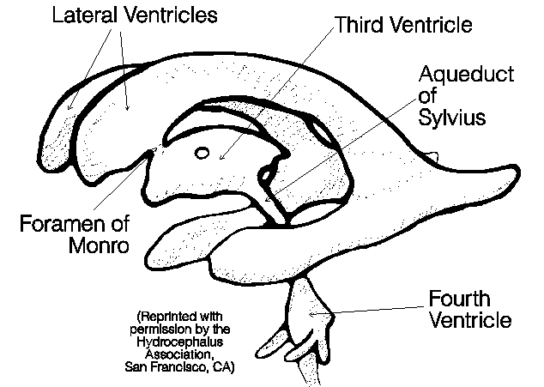

Slide 5
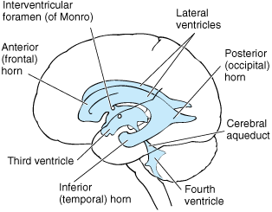
Notes:
Ventricular system

Slide 7
The third ventricle
A cavity situated below the lateral ventricles and between the two parts of the thalamus
Communicates with the fourth ventricle by a canal called cerebral aqueduct

Slide 8
The fourth ventricle
The fourth ventricle has a characteristic diamond shape in cross-sections of the human brain. It is located within the pons or in the upper part of the medulla.
CSF entering the fourth ventricle through the cerebral aqueduct can exit to the subarachnoid space of the spinal cord through two lateral foramina of Luschka (singular: foramen of Luschka)

Slide 9
Applied Anatomy
Hydrocephalus is caused by impaired cerebrospinal fluid (CSF) production, flow or reabsorption.
The most common cause of hydrocephalus is a flow obstruction, hindering the free passage of cerebrospinal fluid through the ventricular system and subarachnoid space (e.g. stenosis of the cerebral aqueduct, obstruction of the interventricular foraminae - foramen of Monro). This can be secondary to tumors, hemorrhages, infections or congenital malfomations. It can also be caused by overproduction of cerebrospinal fluid (relative obstruction).

Slide 10
CEREBROSPINAL FLUID

Slide 11
Cerebrospinal fluid (CSF) is mostly derived through the choroid plexuses.
500mL/day approximately
CSF protects the brain and spinal cord, and collects waste, circulates nutrients, cushions and lubricates the central nervous system (CNS).

Slide 12
The choroid plexus
The choroid plexus is a structure in the ventricles of the brain where cerebrospinal fluid (CSF) is produced. The choroid plexus consists of modified ependymal cells.

Slide 13
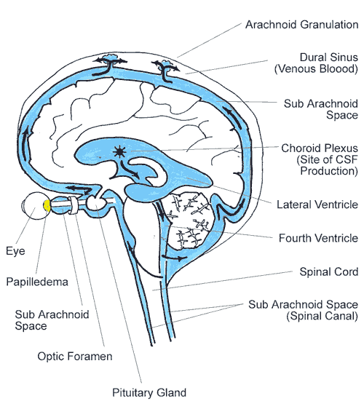
CSF flows from the lateral ventricles via the foramina of Monro into the third ventricle, and then the fourth ventricle via the cerebral aqueduct in the brainstem. From there it can pass into the central canal of the spinal cord or into the cisterns of the subarachnoid space via three small foramina: the central foramen of Magendie and the two lateral foramina of Luschka.

Slide 14
-The CSF contains approximately 0.3% plasma proteins, or approximately 15 to 40 mg/dL.
- CSF pressure ranges from 80 to 100 mmH2O in newborns, and < 200 mmH₂0 in normal children and adults.

Slide 15
The fluid then flows around the superior sagittal sinus to be reabsorbed via the arachnoid villi into the venous system. CSF within the spinal cord can flow all the way down to the lumbar cistern at the end of the cord around the cauda equina where lumbar punctures are performed.

Slide 16
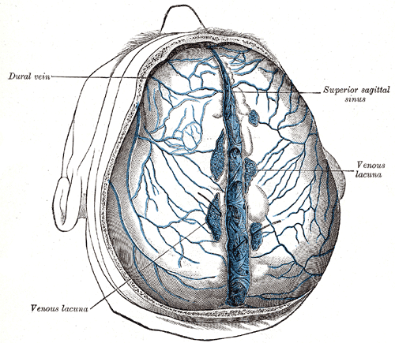
The superior sagittal sinus (also known as the superior longitudinal sinus), within a human cranium, is an area above/behind the brain, which allows blood veins to span the area, from the top of the head towards the back.
It is believed that the cerebrospinal fluid drains through the arachnoid granulations into the dural venous sinuses of the superior sagittal sinus.

Slide 17
Specimen Collection
Lumbar puncture (LP) is the insertion of a needle into the subarachnoid space (the area under the membrane that surrounds the brain and spinal cord) of the lumbar (lower back) region for diagnostic or therapeutic purposes. This allows access to the cerebrospinal fluid (CSF) in which the brain and spinal cord float.
Although the subarachnoid space can be accessed from other levels, the lumbar region is most often used as it allows the needle to be inserted below the end of the spinal cord.

Slide 19
HEMIMEGALENCEPHALY
Synonyms
.Unilateral Megalencephaly
.Macrencephaly
-Hemimegalencephaly is a rare, severe congenital malformation of the brain. As the name implies, an entire hemisphere of cortex, half of the brain, is involved.

Slide 20
-The involved hemisphere is larger than normal.
In addition to being large, it is also profoundly dysfunctional as the brain in that area has not developed properly.
The unaffected side typically has normal cortical development but is abnormally small, because the large abnormal side restricts the normal growth of the unaffected side.

Slide 21
Cause:
Hemimegalencephaly is caused by failure of neurons to migrate and organise themselves in a normal fashion during development of the brain.Various parts of the brain may be affected to various degrees depending on what stage of development the defect occurred.

Slide 22
1.Isolated form
2.Syndromic form : associated with a variety of syndromes . Such associated syndromes include:
Neurofibromatosis type 1 (NF1)
Epidermal nevus synbdrome
Klippel-Trenaunay Syndrome
McCune-Albright syndrome
Proteus syndrome
Tuberous sclerosis
Unilateral hypomelanosis of Ito
3.Total hemimegalencephaly : Hemihypertrophy also involves the brainstem and cerebellum.

Slide 23
Symptoms:
-Seizures.
-Intracranial hypertension .
-Separation of skull bones .
-Bulging fontanels.
-Progressive paralysis on one side of the body .
-Hemianopia.
-Mental retardation.

Slide 24
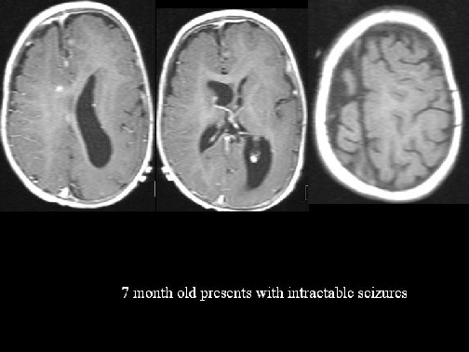

Slide 25
1.The Klippel-Trénaunay-Weber syndrome (KTWS)is a syndrome combination of capillary malformations, soft-tissue or bone hypertrophy, and varicose veins or venous malformations.
2.The McCune-Albright syndrome is characterised by the association of :
-leg pain, pathological fracture : ~ 75%
-abnormal vaginal bleeding : ~ 25%
- Cafe-au-lait spots
predominantly on back of trunk : ~ 30 - 50%
often ipsilateral to bone lesions

Slide 26
3.The tuberous sclerosis (TS) complex or Bourneville disease is a neurocutaneous disorder (phakomatosis) characterized by development of multiple benign tumours of the embryonic ectoderm, e.g. skin, eyes, nervous system.
4.Proteus syndrome causes an overgrowth of skin, bones, muscles, fatty tissues, and blood and lymphatic vessels.

Slide 27
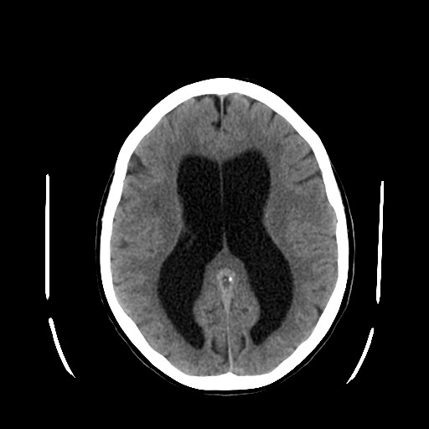
Hydrocephalus

Slide 28
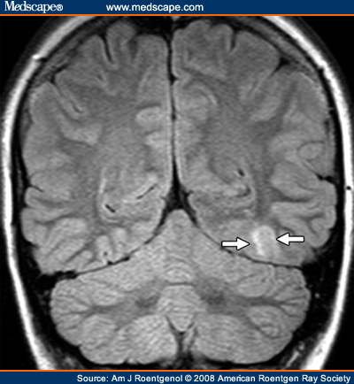
Cortical dysplasia

Slide 29
HEMISPHERECTOMY
If the affected side is surgically removed , the remaining healthy side of the brain may gradually take over the functions whose control has been lost. The ability for one side of the brain to take over the function of the other is known as "plasticity.”

Slide 30
THANK YOU

Slide 31
Position
Lies above and behind the medullar and pons and occupies posterior cranial fossa
Cerebellum

Slide 32
Lobs
Two deep fissures
Primary fissure
Posterolateral fissure
Three lobs
Flocculonodular lobe
flocculus and nodule
Anterior lobe
Posterior lobe
Corpus of
cerebellar

Slide 33
External features
Consists of two cerebellar hemisphere united in the midline by the vermis

Slide 34
Lobs
Anterior lobe
corpus of
cerebellar
Primary fissure
Posterior lobe
Flocculonodular lobe
Posterolateral fissure

Slide 35
Internal structures
Gray matter
Cerebellar cortex
Cerebellar nuclei
Dentate nucleus
Fastigial nucleus
Interposed nucleus
Emboliform nucleus
Globose nucleus
White matter－medullary center

Slide 36
Internal structures
Cerebellar cortex
Fastigial nucleus
Globose nucleus
Dentate nucleus
Emboliform nucleus
medullary center

Slide 37
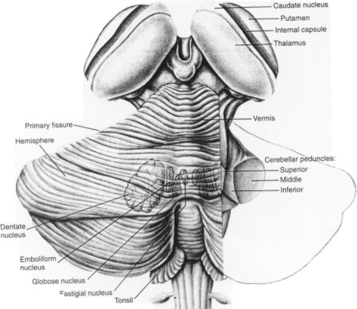

Slide 38
Cerebellar Anatomy
Cerebellar Cortex
Deep Cerebellar Nuclei:
Dentate
Interposed
Fastigial
PNS Fig. 42-1

Slide 39
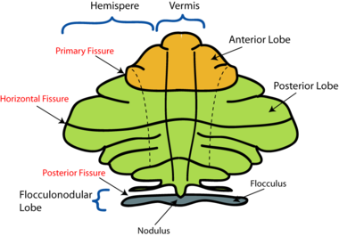

Slide 40
The Cerebellum

Slide 41
FUNCTIONAL DIVISIONS
CEREBELLUM
a. Traditional / Transverse or Horizontal division
b. Vertical / Longitudinal Division

Slide 42
FUNCTIONAL DIVISIONS
TRADITIONAL
Archicerebellum
Paleocerebellum
Neocerebellum
VERTICAL
Lateral
Intermediate
Vermal

Slide 43
Three functional divisions
Vestibulocerebellum
Archicerebellum
Flocculonodular lobe
Spinocerebellum
Paleocerebellum
Vermis and intermediate zone
Cerebrocerebellum
Neocerebellum
Lateral zone
Vermis
Intermediate zone
Lateral zone
Flocculonodular lobe

Slide 44
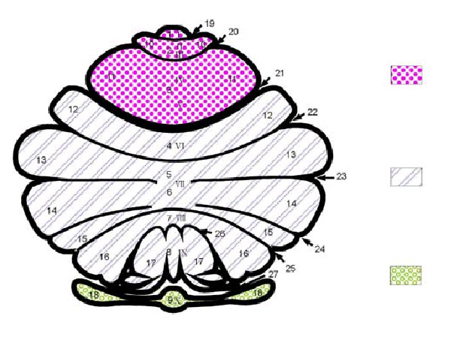
Spinocerebellum
Pontocerebellum
Vestibulocerebellum

Slide 45
VERTICAL / LONGITUDINAL DIVISION

Slide 46
MIDSAGITTAL SECTION OF THE VERMIS

Slide 47
ARCHICEREBELLUM
Oldest part
Flocculonodular Lobe
Lobule X of vermis
Functions for EQUILIBRIUM

Slide 48
PALEOCEREBELLUM
Anterior Lobe
Lobule I – V of vermis
Function for PROPULSIVE, STEREOTYPE MOVEMENTS

Slide 49
NEOCEREBELLUM
Most recent part
Posterior Lobe
Lobule VI – IX of Vermis
Functions for COORDINATION OF SKILLED VOLUNTARY MOVEMENTS, CONTROL OF EQUILIBRIUM AND MUSCLE TONE

Slide 50
CONNECTIONS OF THE CEREBELLUM
1. Tectocerebellar tract
2. Olivocerebellar tract
3. Vestibulocerebellar tract
4. Cuneocerebellar tract
5. Dorsal spinocerebellar tract
6. Cerebellar Peduncles

Slide 51
Damage to the cerebellum
Causes a lack of co-ordination:
Speaking
Walking
Tremour

Slide 52
Cerebellar Stroke
Dizziness, vomiting
Unsteady so that walking is impossible
Power, tone and reflexes normal
Area of blood in the cerebellum would show on a CT scan

Slide 54
Cerebellar Cognitive Affective Disorder
Lesions of the posterior cortex and vermis
Impairment of executive functions
Planning, verbal fluency, abstract reasoning
Difficulties with spatial cognition
Visuo-spatial organization, visual memory
Personality changes
Blunting of affect, inappropriate behaviors
Language disorders
Agrammatism

